Slide 1



Slide 2
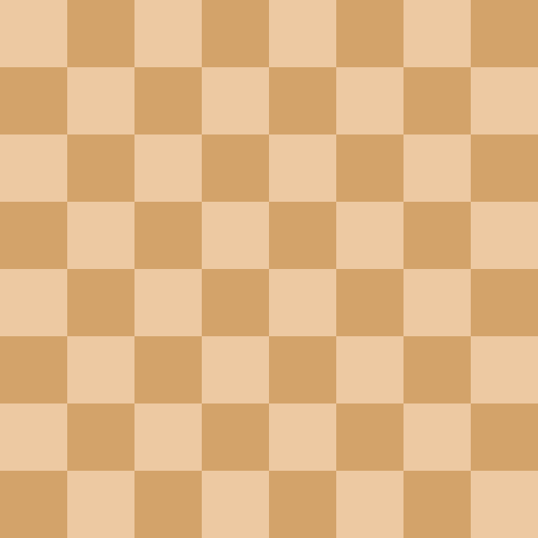

Chess King’s Council
Load Game
New Game

Slide 4
Chess King’s Council
Load Game
New Game
Create Piece

Slide 5
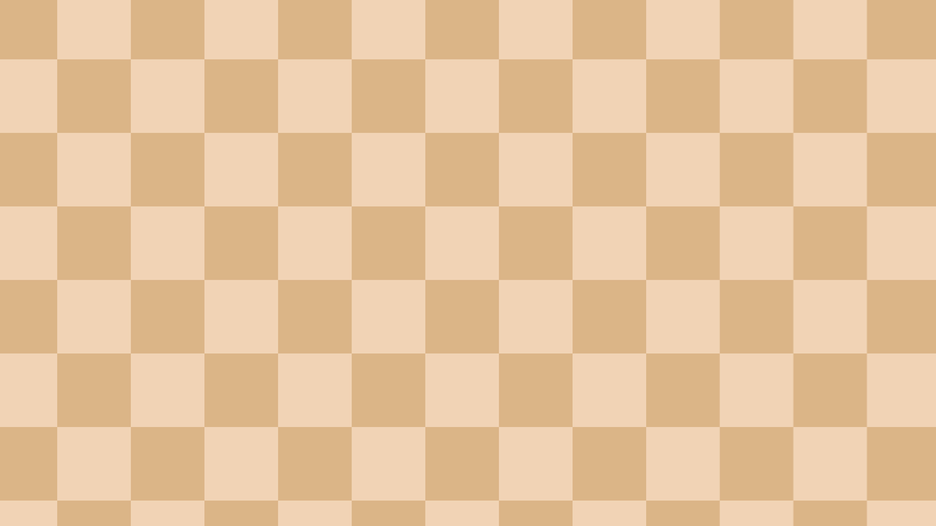

Coming Soon!

Slide 6
Council of Kings

Slide 7
New Game
Play

Slide 8
Enter Name:

Slide 9
Play As:
white
black
test

